Slide 1
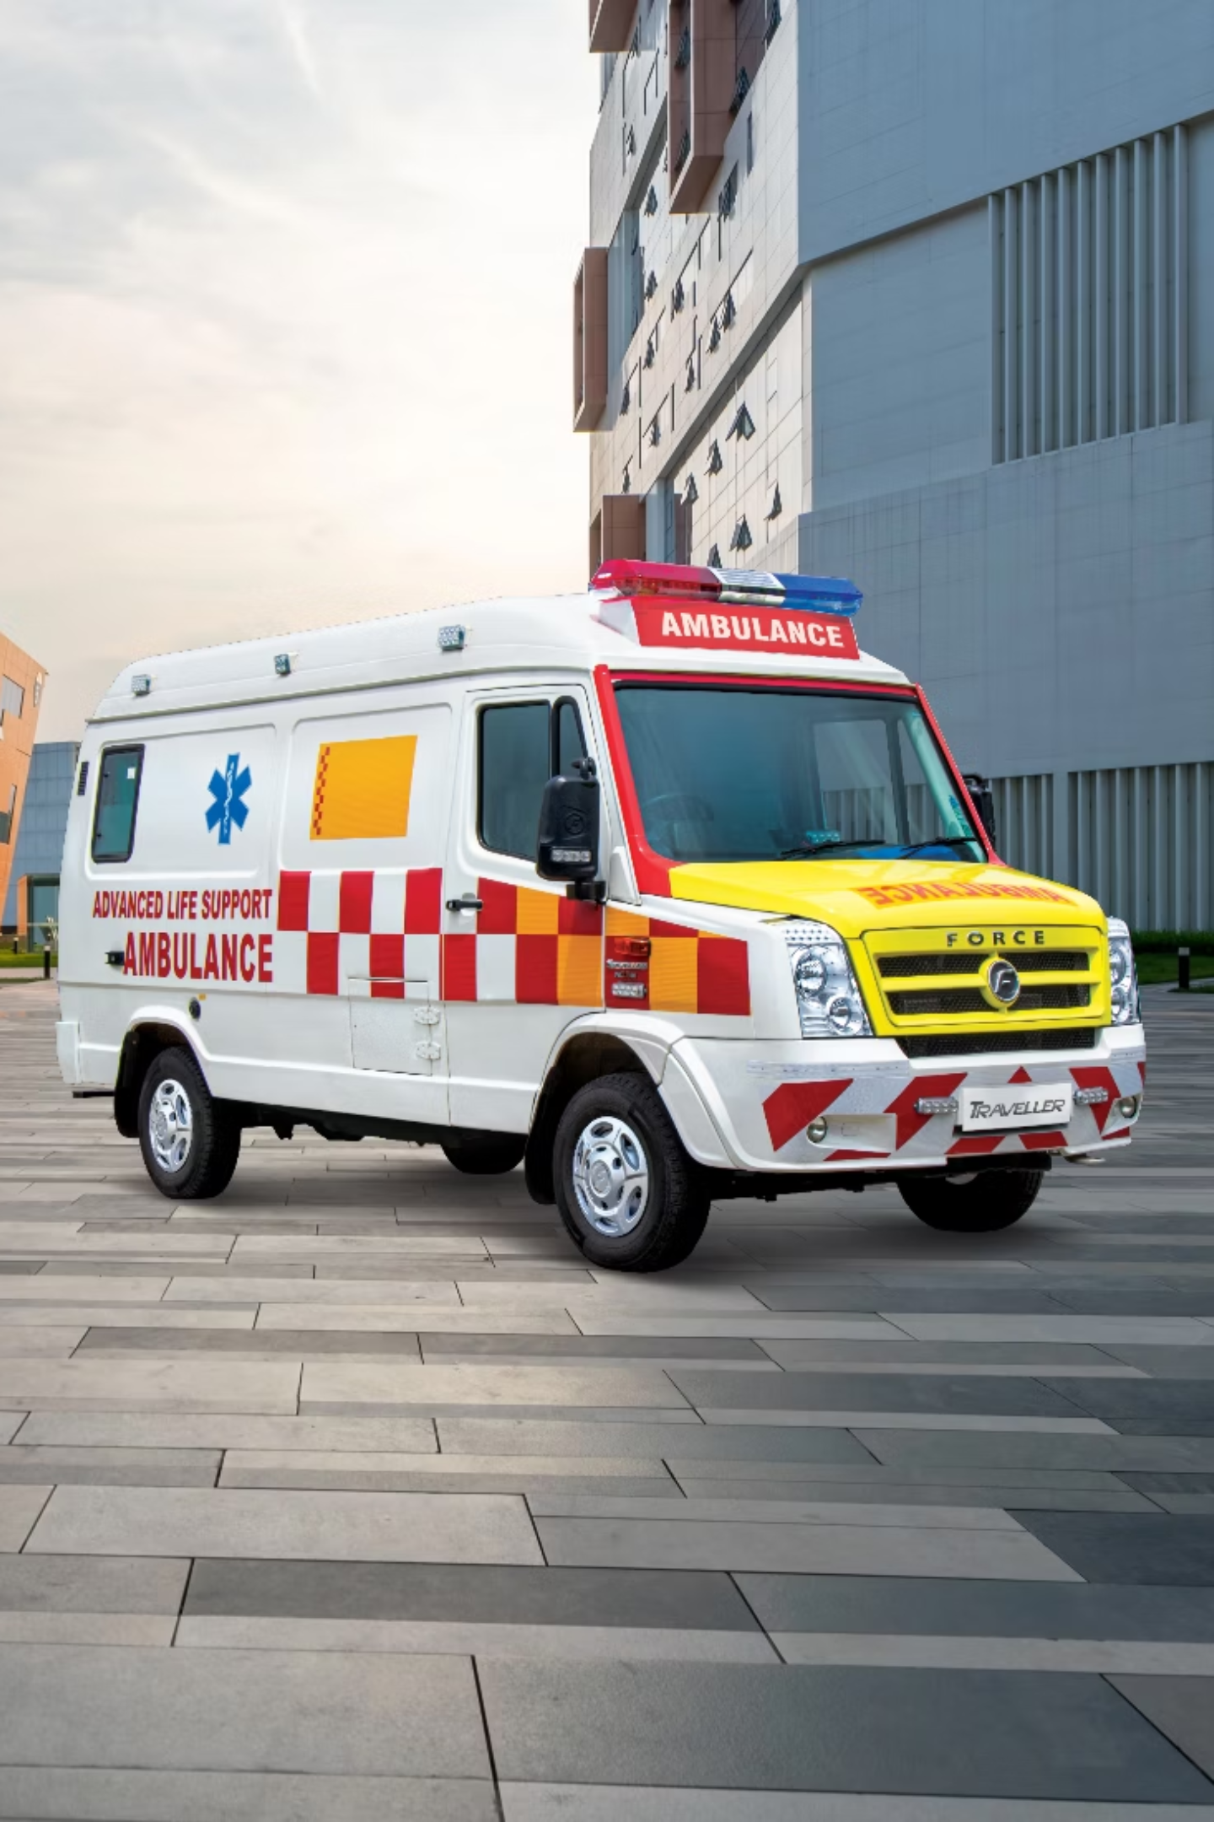
Traffic-Pulse: Intelligent Signal Optimisation
SAB Squad | Chandigarh University

Slide 2


CHALLENGE
The Problem We're Solving
Signal Coordination
Emergency Priority
Optimise 3-4 interconnected intersections efficiently
Reduce emergency vehicle delay by 60%
Learning System
Q-learning improves within 500 episodes

Slide 3
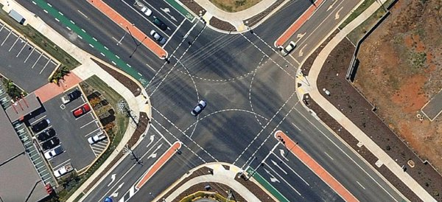

SYSTEM
Intersection Architecture
Layout Design
Detection Systems
4 roads: North, East, South, West
YOLOv11 camera per road
Audio siren detection
Opposite pairs green together (0-2, 1-3)
Dual confirmation: 0.6 threshold
60s green, 5s yellow transition

Slide 4



Operating Modes
Normal Mode
Emergency Mode
Resume Normal
Standard timed cycles for regular traffic flow
Priority green for emergency vehicles detected
Return to standard after vehicle passes

Slide 5
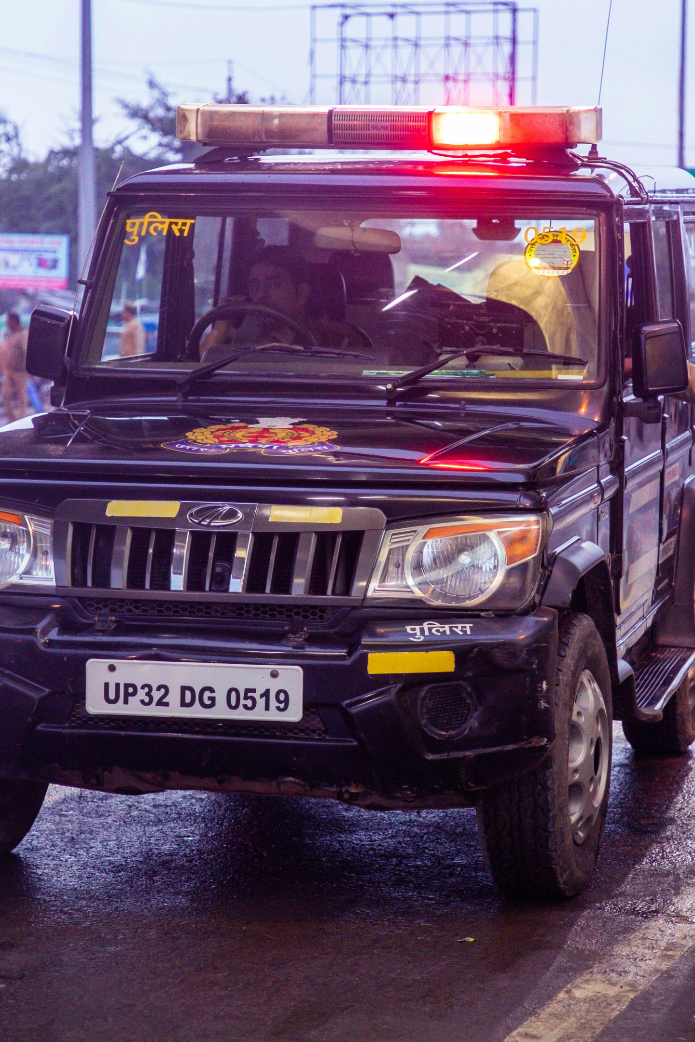

SAFETY
Emergency Vehicle Handling
01
Dual Detection
Vision + audio confirmation required
02
Priority Queue
First detected receives green signal
03
Yellow Transition
Always 5s buffer prevents accidents
04
Conflict Resolution
Timestamp-based priority system

Slide 6


Success Metrics
60%
40%
Emergency Delay Cut
Maximum Delay
Target reduction achieved
Emergency vehicles vs normal
Learning Progress
Performance Tracking
Wait time drops over 500 episodes
Wait time and throughput metrics
Dashboard visualises flow states
Explainable signal decisions

Slide 7
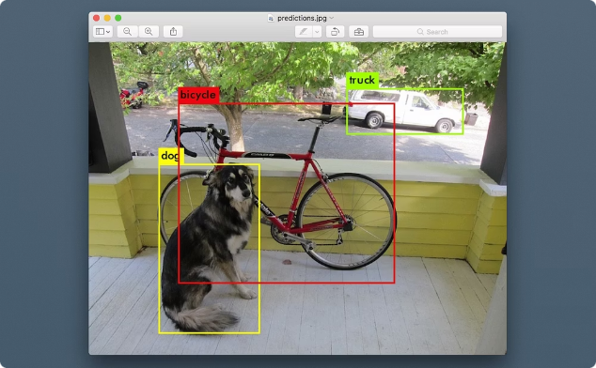

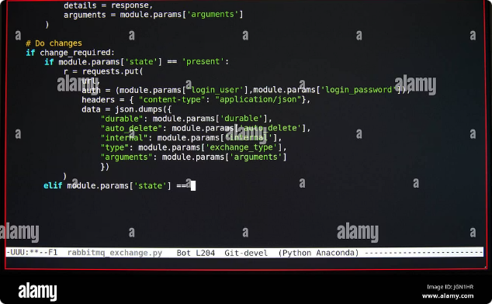

Technology Stack
YOLOv11 Vision
Audio Detection
Python Implementation
Real-time ambulance detection model
Siren identification system
Simulation and web application
Team SAB Squad – Delivering intelligent traffic optimisation through AI-powered signal control

